Slide 1
Emerging Technologies for the Circular Economy
Lecture 2: Circular Economy
Prof. Dr. Benjamin Leiding (Clausthal)
Dr. Arne Bochem (Göttingen)
M.Sc. Anant Sujatanagarjuna (Clausthal)
M.Sc. Shohreh Kia (Clausthal)
Notes:
<number>

Slide 2
License
This work is licensed under a Creative Commons Attribution-ShareAlike 4.0 International License. To view a copy of this license, please refer to https://creativecommons.org/licenses/by-sa/4.0/ .
Updated versions of these slides will be available in our Github repository.

Slide 3
News/Updates

Slide 4
Lectures – IoT and Digitalization for the Circular Economy
17.04.2023 → Organization (L00) + Introduction (L01)
24.04.2023 → Circular Economy (L02)
08.05.2023 → Lifecycle Assessment – LCA (L03)
15.05.2023 → Introduction to the Internet of Things (L04)
22.05.2023 → Internet of Things – Communication + Security and Privacy (L05)
05.06.2023 → Internet of Things – Data Processing and BigData (L06)
→ Extra MOOC - Foodsharing
12.06.2023 → Industrial Internet of Things (L07)
19.06.2023 → No Lecture
26.06.2023 → IoT in Mining I (L08)
03.07.2023 → IoT in Mining II (L09)
→ Technologies for Sustainability – MOOC Content (L10)
10.07.2023 → Coding Workshop I (Goslar)
17.07.2023 → Coding Workshop II (Goslar)
31.07.2023 → Exam Q&A

Slide 5
Exercises – IoT and Digitalization for the Circular Economy
17.04.2023 → Exercise 01 – Carbon Footprint
24.04.2023 → Exercise 02 – Performance Economy
01.05.2023 → Exercise 03 – Your Favourite Fruit or Vegetable
08.05.2023 → Exercise 04 – LCA of Your Favourite Fruit or Vegetable
12.06.2023 → Exercise 05 – Industrial IoT
03.07.2023 → Exercise 06 – IoT in Mining
10.07.2023 → Exercise 07 – Technology Assessment

Slide 6
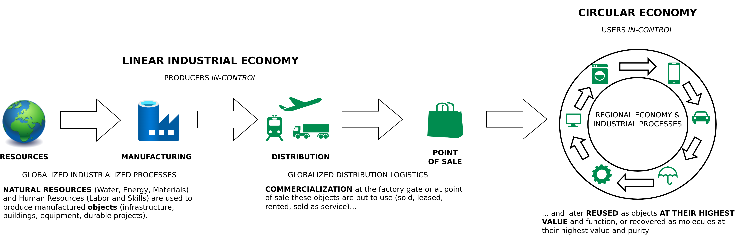
The Linear (Industrial) Economy
Image adapted from: Walter R. Stahel (2019) – The Circular Economy: A User’s Guide.

Slide 7
The Circular Economy

Slide 8
Circular Economy
Image adapted from https://www.ellenmacarthurfoundation.org/circular-economy/concept/infographic

Slide 9
Circular Economy
Center for Digital Technologies (DIGIT) (2022) – https://www.digit-research.de/fileadmin/DIGIT/Presse_und_News/Downloads/Grafikpaket_Reallabor_DCE_Kreislaufmodell_V2_ccby.zip – CC BY 4.0.

Slide 10
Circular Economy – Definitions
“Conceptualizing the circular economy: An analysis of 114 definitions.”
Kirchherr, Julian, Denise Reike and Marko P. Hekkert. Resources Conservation and Recycling 127 (2017): 221-232.
https://doi.org/10.1016/J.RESCONREC.2017.09.005
Kirchherr, J., Reike, D., & Hekkert, M. (2017) – Conceptualizing the circular economy: An analysis of 114 definitions. Resources, conservation and recycling, 127, 221-232.

Slide 11
Circular Economy – Definitions
“A circular economy is an industrial system that is restorative or regenerative by intention and design. It replaces the ‘end-of-life’ concept with restoration, shifts towards the use of renewable energy, eliminates the use of toxic chemicals, which impair reuse, and aims for the elimination of waste through the superior design of materials, products, systems, and, within this, business models.”
– Ellen MacArthur Foundation
https://www.ellenmacarthurfoundation.org/assets/downloads/publications/Ellen-MacArthur-Foundation-Towards-the-Circular-Economy-vol.1.pdf

Slide 12
Circular Economy – Definitions
“A circular economy is an industrial system that is restorative or regenerative by intention and design. It replaces the ‘end-of-life’ concept with restoration, shifts towards the use of renewable energy, eliminates the use of toxic chemicals, which impair reuse, and aims for the elimination of waste through the superior design of materials, products, systems, and, within this, business models.”
– Ellen MacArthur Foundation
“The circular economy is a model of production and consumption, which involves sharing, leasing, reusing, repairing, refurbishing and recycling existing materials and products as long as possible. In this way, the life cycle of products is extended.”
– European Parliament
https://www.ellenmacarthurfoundation.org/assets/downloads/publications/Ellen-MacArthur-Foundation-Towards-the-Circular-Economy-vol.1.pdf
https://www.europarl.europa.eu/news/en/headlines/economy/20151201STO05603/circular-economy-definition-importance-and-benefts
Notes:
<number>

Slide 13
Circular Industrial Economy – Definitions
“The circular industrial economy manages stocks of manufactured assets, such as infrastructure, buildings, vehicles, equipment and consumer goods, to maintain their value and utility as high as possible for as long as possible; and stocks of resources at their highest purity and value.”
Walter R. Stahel (2019) – The Circular Economy: A User’s Guide.

Slide 14
Sustainability – Definition
„Development that meets the needs of the present without compromising the ability of future generations to meet their own needs.”
Report of the World Commission on Environment and Development: Our Common Future (1987) – http://www.un-documents.net/our-common-future.pdf

Slide 15
Sustainability – Definition
Social
Economic
Environment
Based on: Thomsen C. (2013) Sustainability (World Commission on Environment and Development Definition). In: Idowu S.O., Capaldi N., Zu L., Gupta A.D. (eds) Encyclopedia of Corporate Social Responsibility. Springer, Berlin, Heidelberg. https://doi.org/10.1007/978-3-642-28036-8_531

Slide 16
Sustainability – Definition
Social
Viable
Economic
Environment
Based on: Thomsen C. (2013) Sustainability (World Commission on Environment and Development Definition). In: Idowu S.O., Capaldi N., Zu L., Gupta A.D. (eds) Encyclopedia of Corporate Social Responsibility. Springer, Berlin, Heidelberg. https://doi.org/10.1007/978-3-642-28036-8_531

Slide 17
Sustainability – Definition
Social
Bearable
Equitable
Viable
Economic
Environment
Based on: Thomsen C. (2013) Sustainability (World Commission on Environment and Development Definition). In: Idowu S.O., Capaldi N., Zu L., Gupta A.D. (eds) Encyclopedia of Corporate Social Responsibility. Springer, Berlin, Heidelberg. https://doi.org/10.1007/978-3-642-28036-8_531

Slide 18
Sustainable
Sustainability – Definition
Social
Bearable
Equitable
Viable
Economic
Environment
Based on: Thomsen C. (2013) Sustainability (World Commission on Environment and Development Definition). In: Idowu S.O., Capaldi N., Zu L., Gupta A.D. (eds) Encyclopedia of Corporate Social Responsibility. Springer, Berlin, Heidelberg. https://doi.org/10.1007/978-3-642-28036-8_531

Slide 19
Sustainability – Implications
Sustainability → Consume less
Report of the World Commission on Environment and Development: Our Common Future (1987) – http://www.un-documents.net/our-common-future.pdf

Slide 20
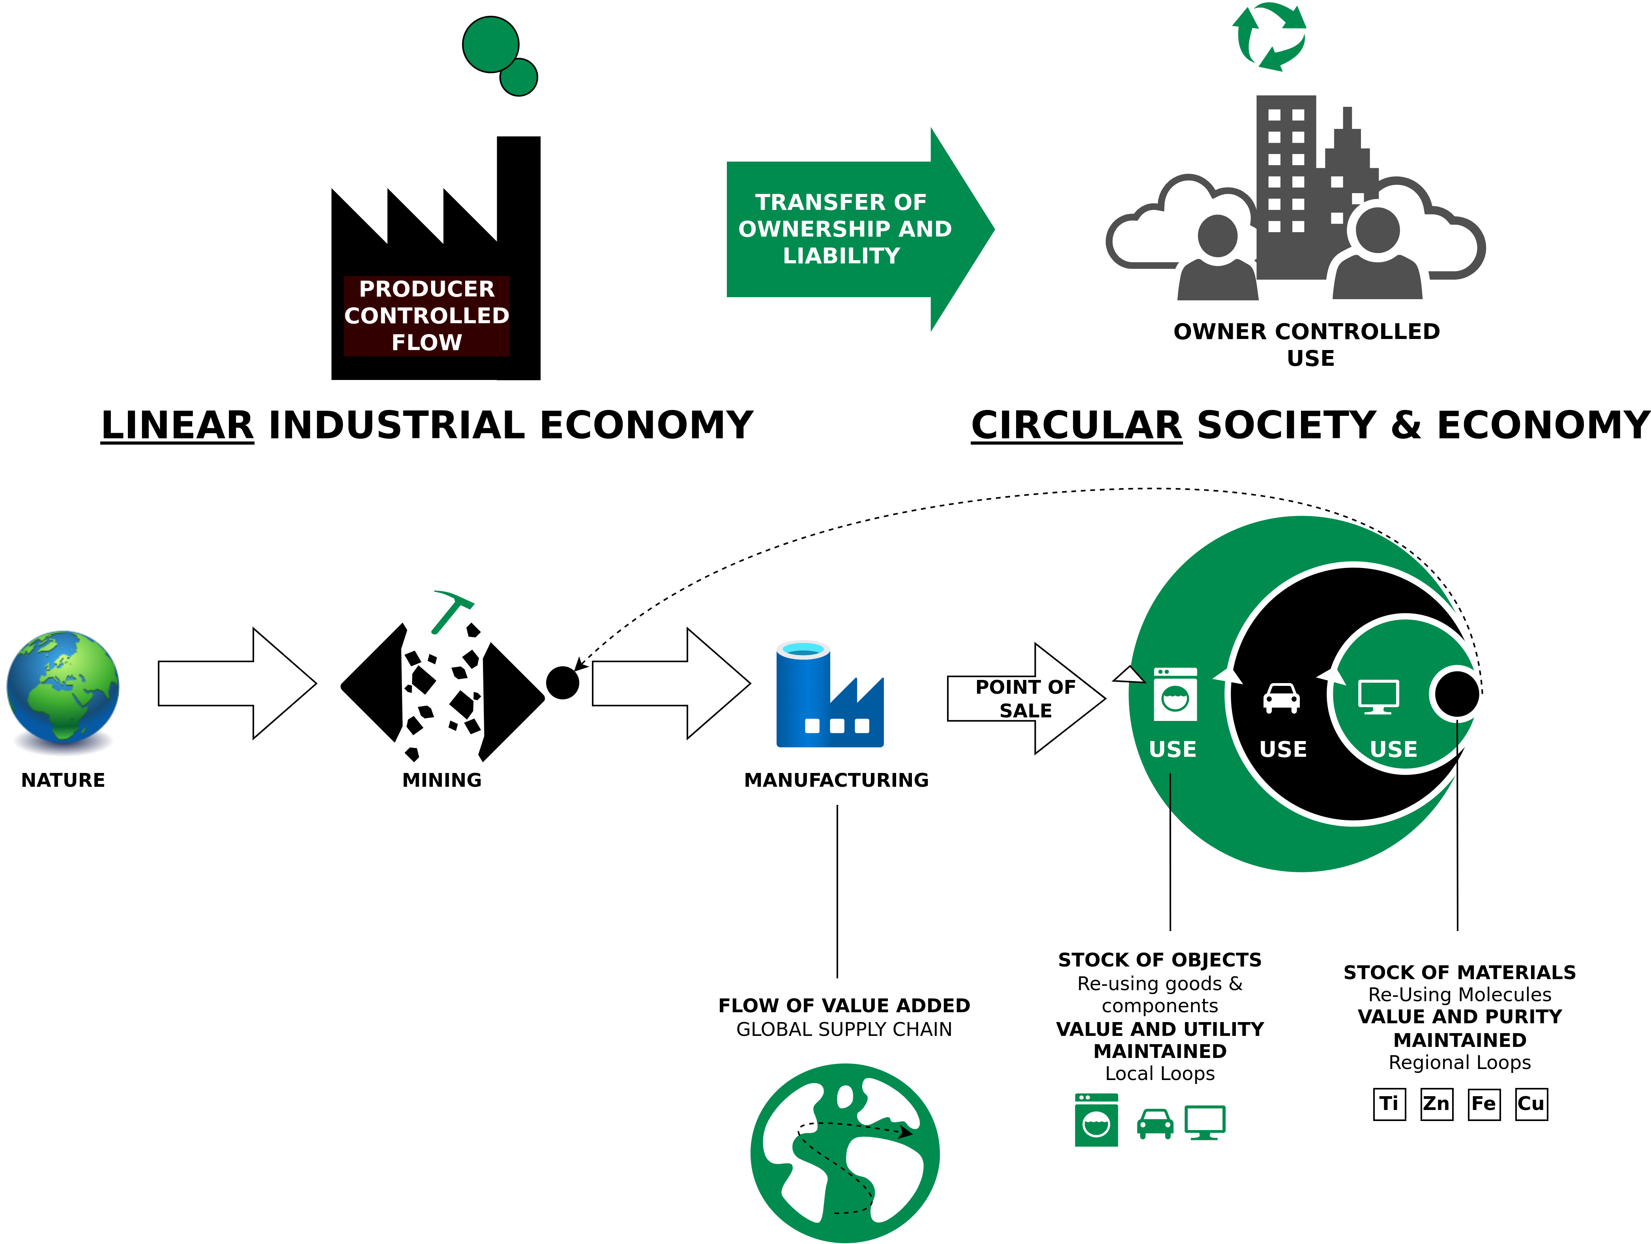
Circular Economy – Characteristics
Image adapted from: Walter R. Stahel (2019) – The Circular Economy: A User’s Guide.

Slide 21
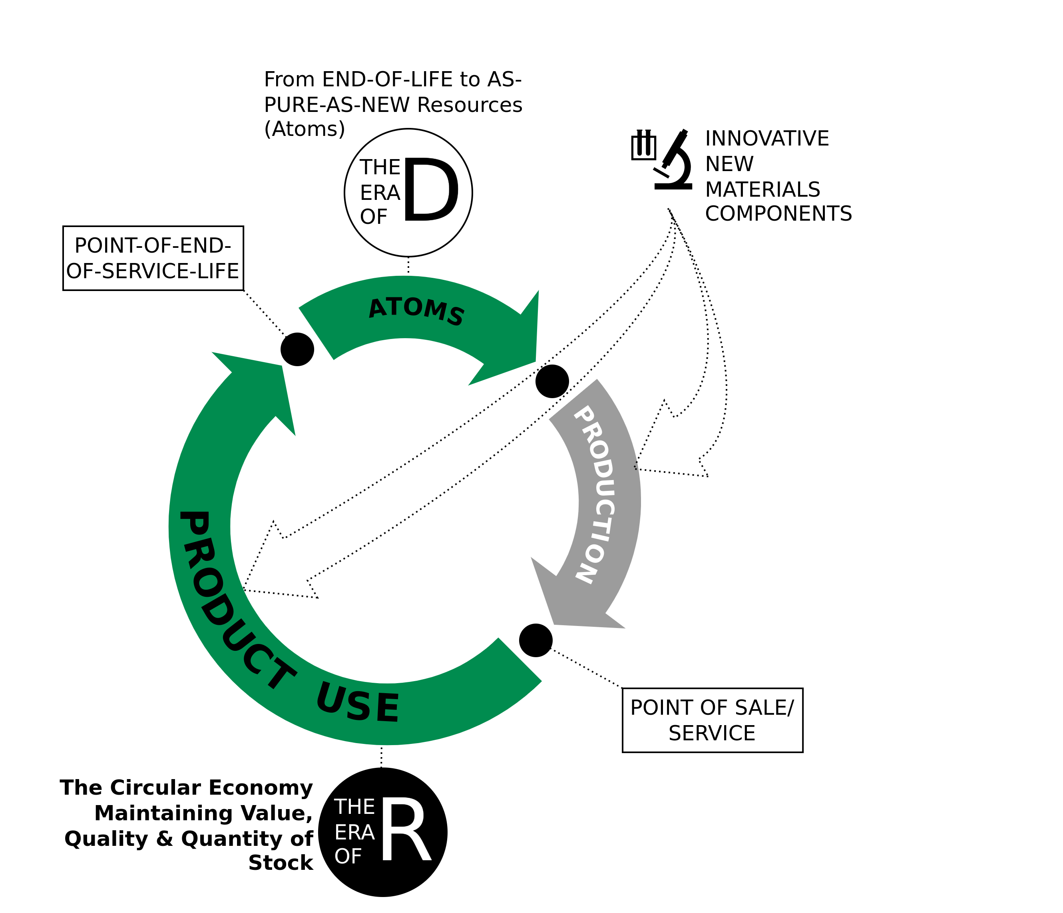
The Era of R
Techno-commercial strategies to keep goods and components at highest value level through:
Reuse
Repair
Remarket
Remanufacture
Re-refine
Reprogramme goods
Image adapted from Walter R. Stahel (2019) – The Circular Economy: A User’s Guide.

Slide 22
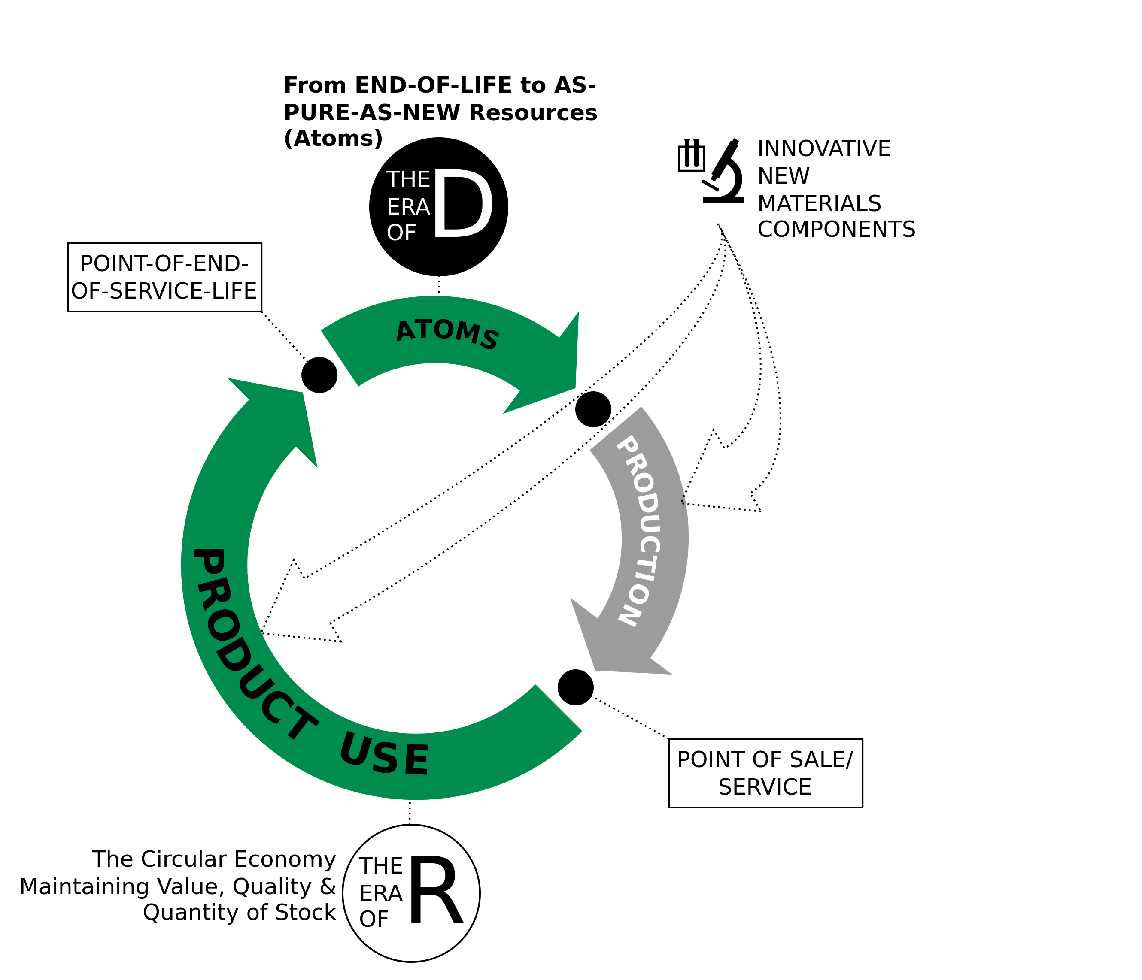
The Era of D
Technologies and actions to recover atoms and molecules at highest quality (purity and value) level as pure as virgin:
De-polymerise
De-alloy
De-laminate
De-vulcanise
De-coat materials
De-construct high-rise buildings and major infrastructure
Image adapted from Walter R. Stahel (2019) – The Circular Economy: A User’s Guide.

Slide 23
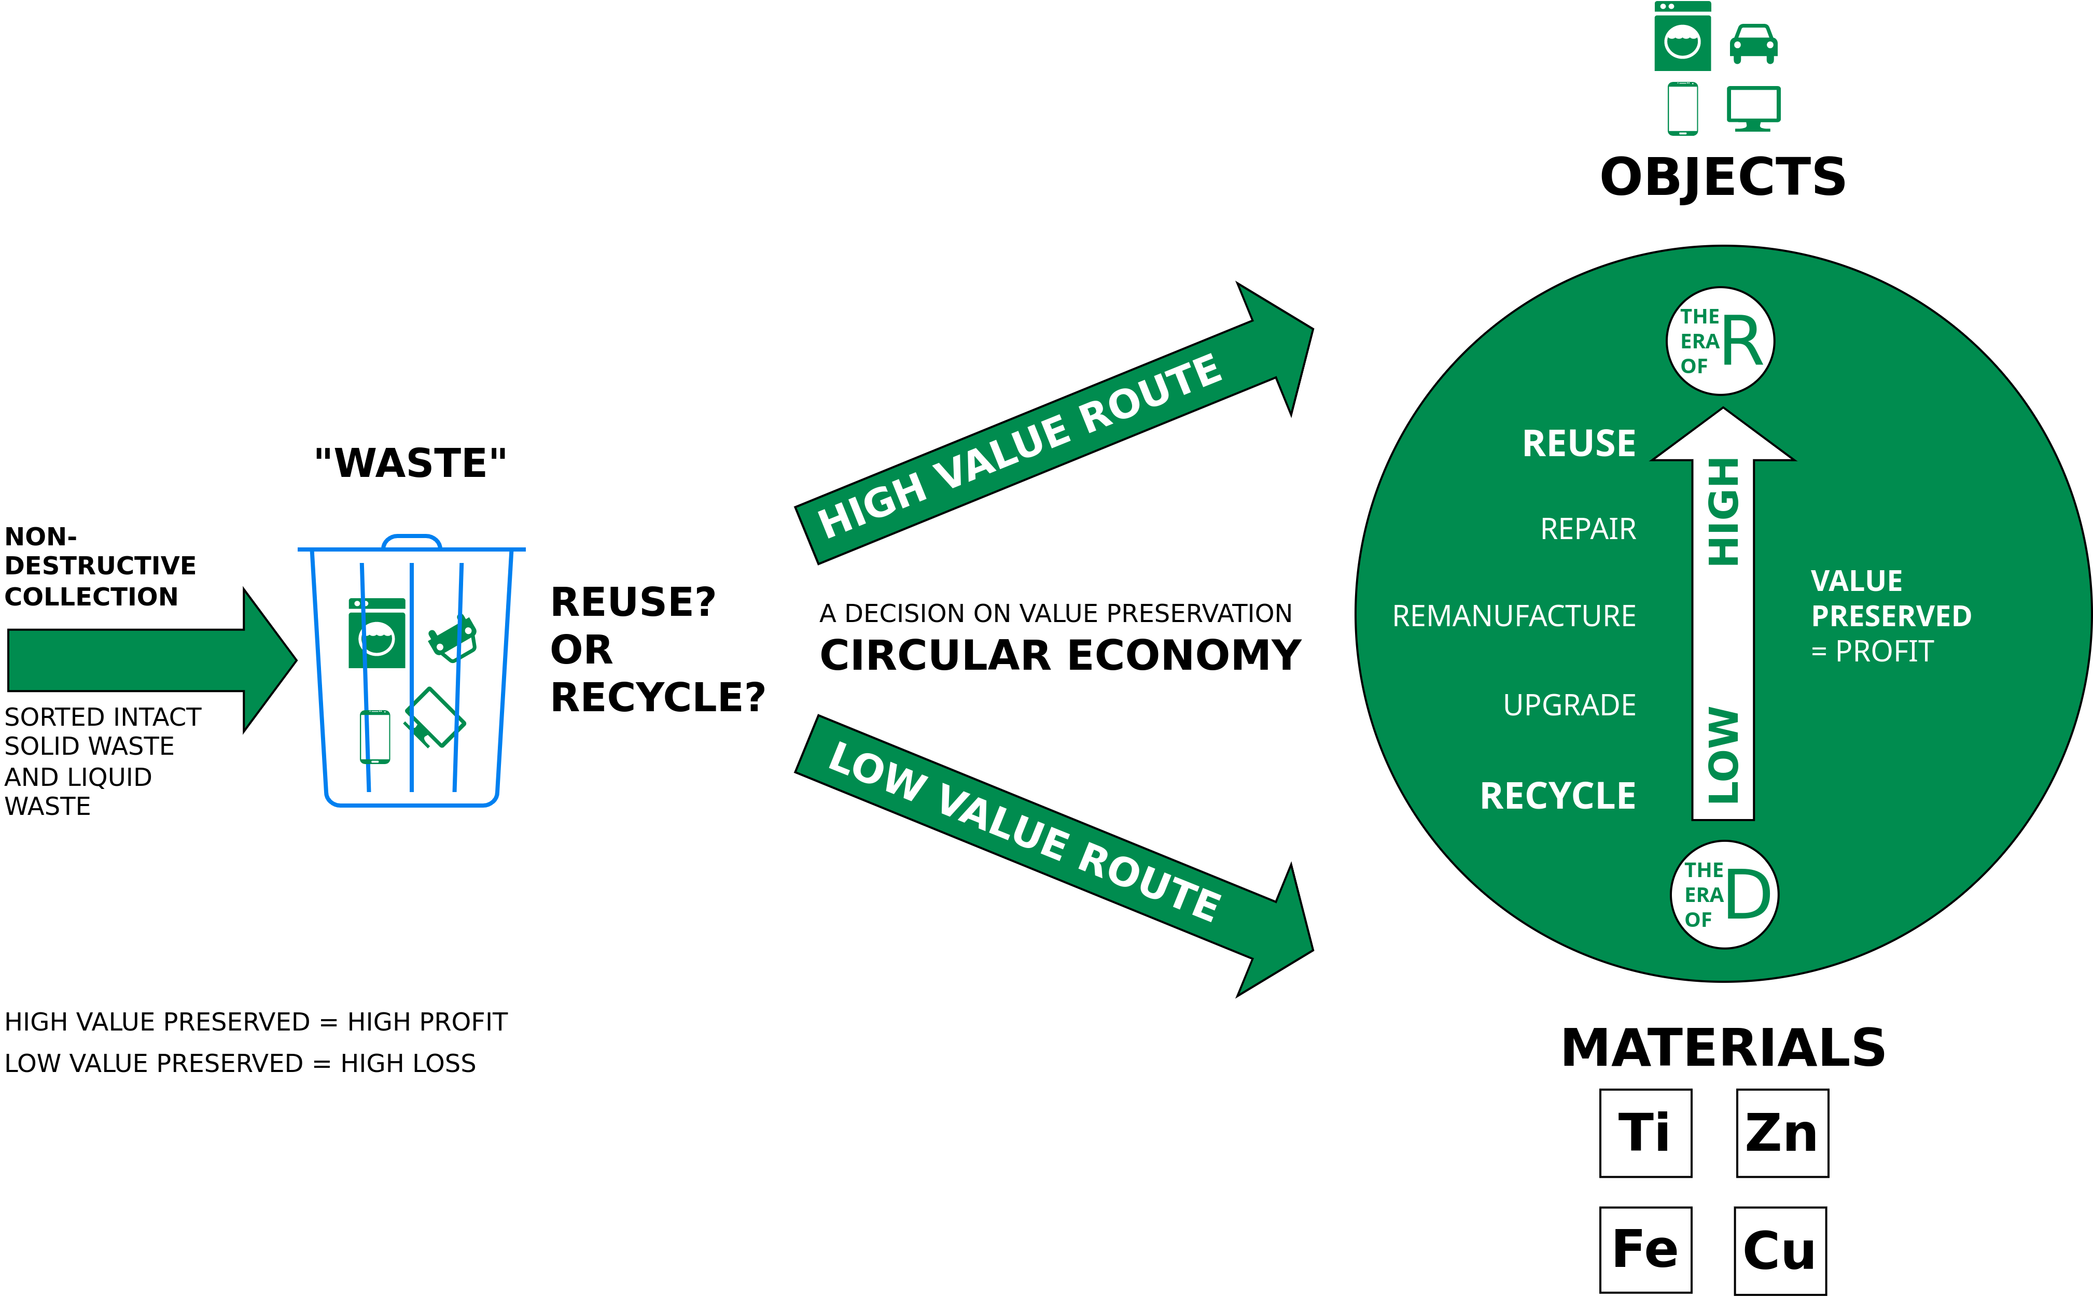
End-of-service-life business opportunities for value preservation: Reuse or Recycle?
Image adapted from Walter R. Stahel (2019) – The Circular Economy: A User’s Guide.

Slide 24
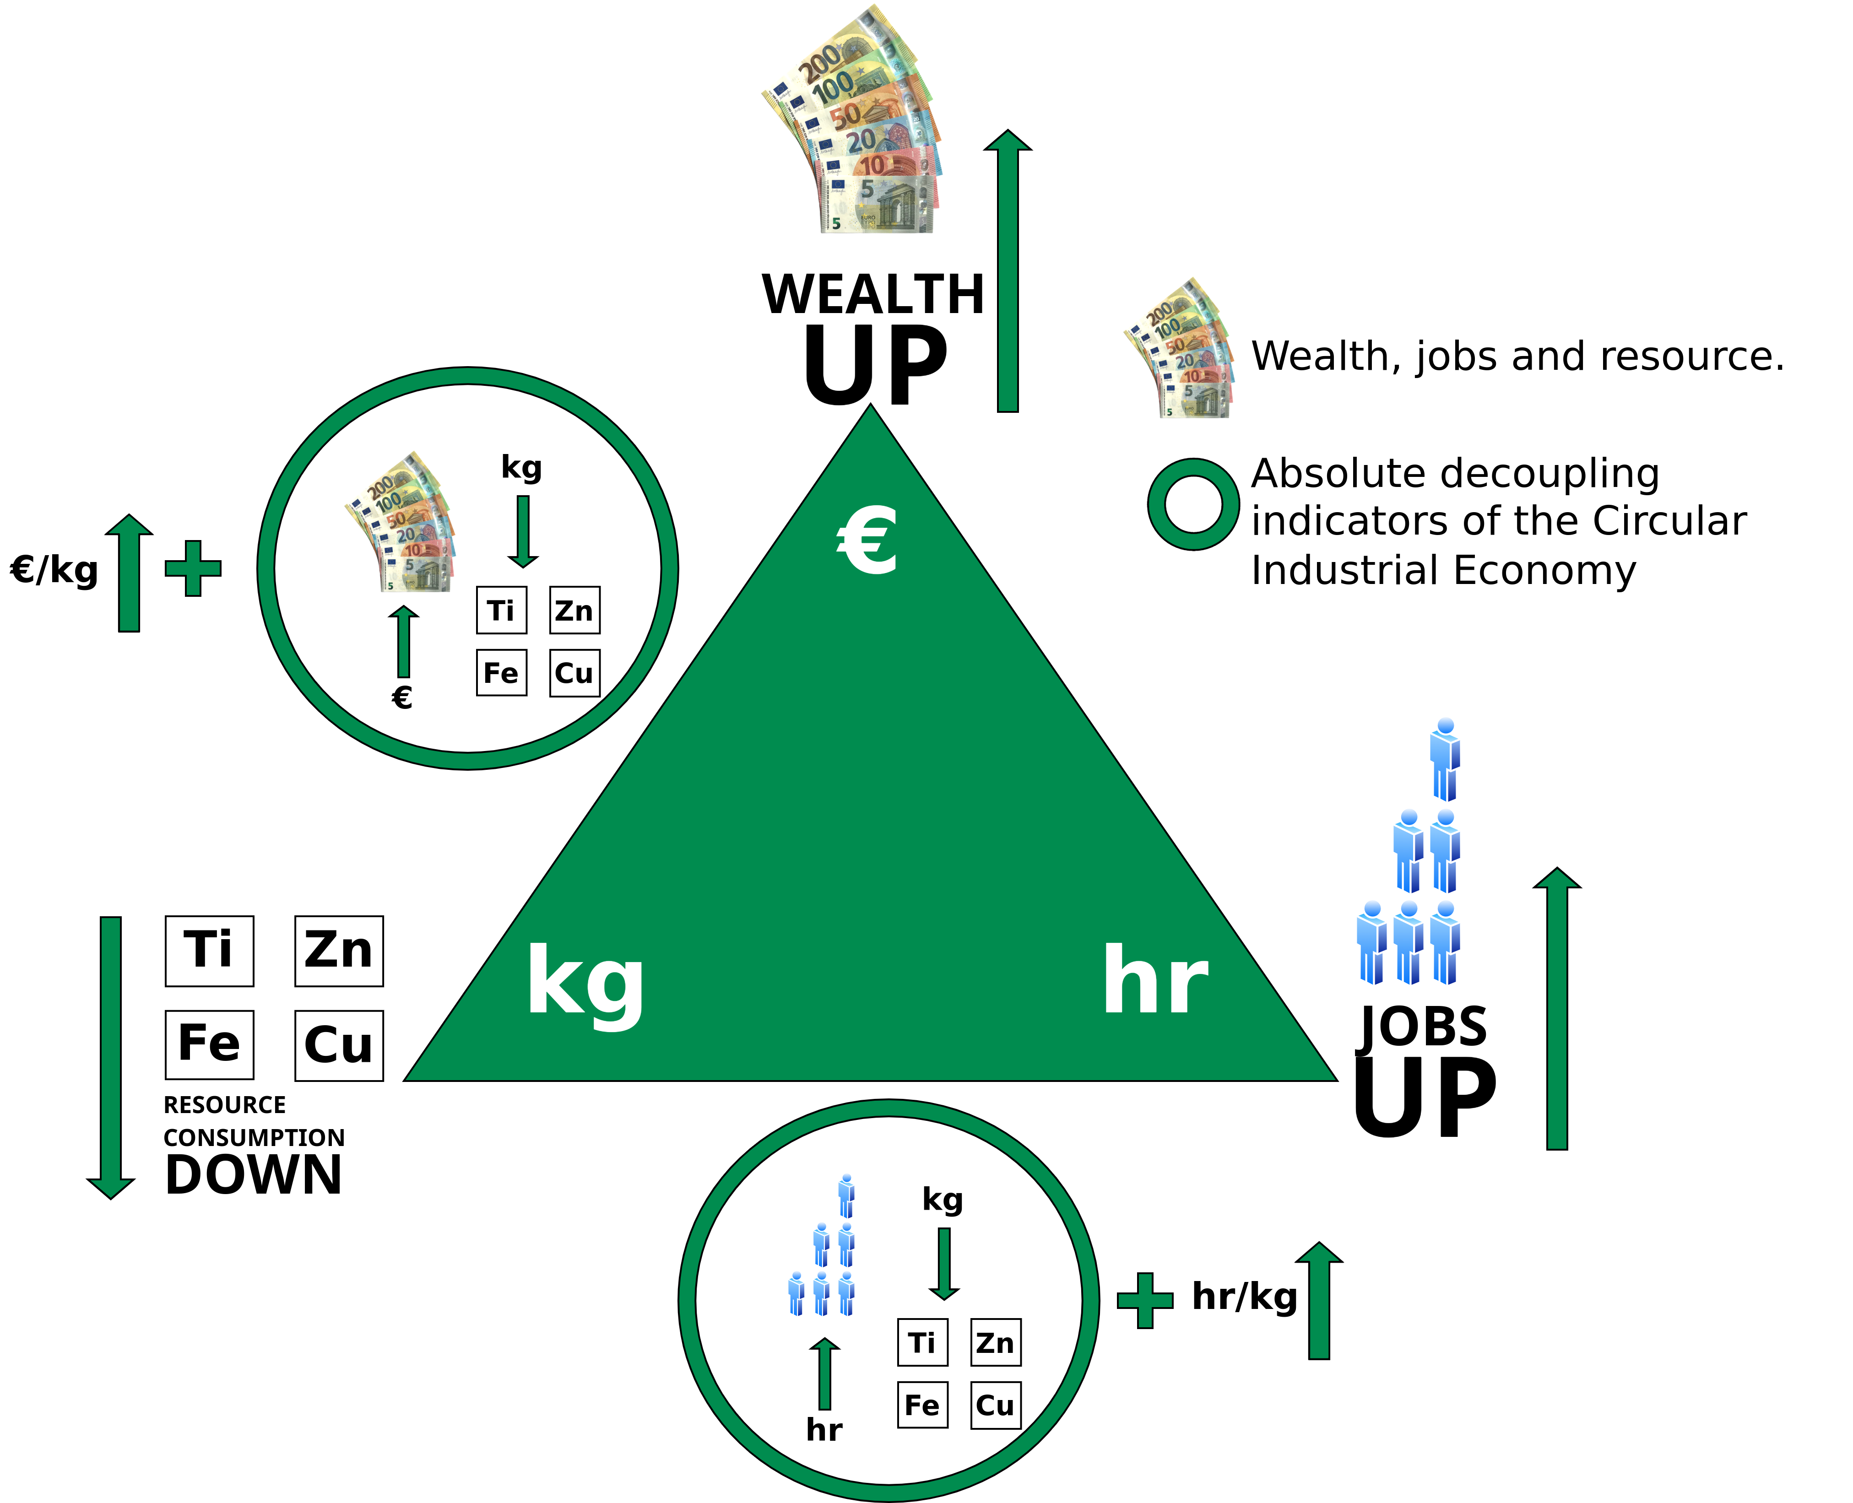
The two absolute decoupling indicators of the CIE monitoring more wealth and jobs from less resource consumption
Linear Economy: Low hr/kg (labor input per weight) ratios, coherent with mass production in highly mechanized processes, and low to medium €/kg (value per weight) ratios, in a range from basic materials like cement to smart goods like USB memory sticks
Circular Economy: Higher hr/kg and €/kg ratios for reuse, remanufacture and selling performance (goods as a service), in a group with new technologies, such as life sciences and nanotechnologies, which by nature produce dematerialized objects.
Image adapted from Walter R. Stahel (2019) – The Circular Economy: A User’s Guide.

Slide 25
The two absolute decoupling indicators of the CIE monitoring more wealth and jobs from less resource consumption
Linear Economy: Low hr/kg (labor input per weight) ratios, coherent with mass production in highly mechanized processes, and low to medium €/kg (value per weight) ratios, in a range from basic materials like cement to smart goods like USB memory sticks
Circular Economy: Higher hr/kg and €/kg ratios for reuse, remanufacture and selling performance (goods as a service), in a group with new technologies, such as life sciences and nanotechnologies, which by nature produce dematerialized objects.
Image adapted from Walter R. Stahel (2019) – The Circular Economy: A User’s Guide.

Slide 26
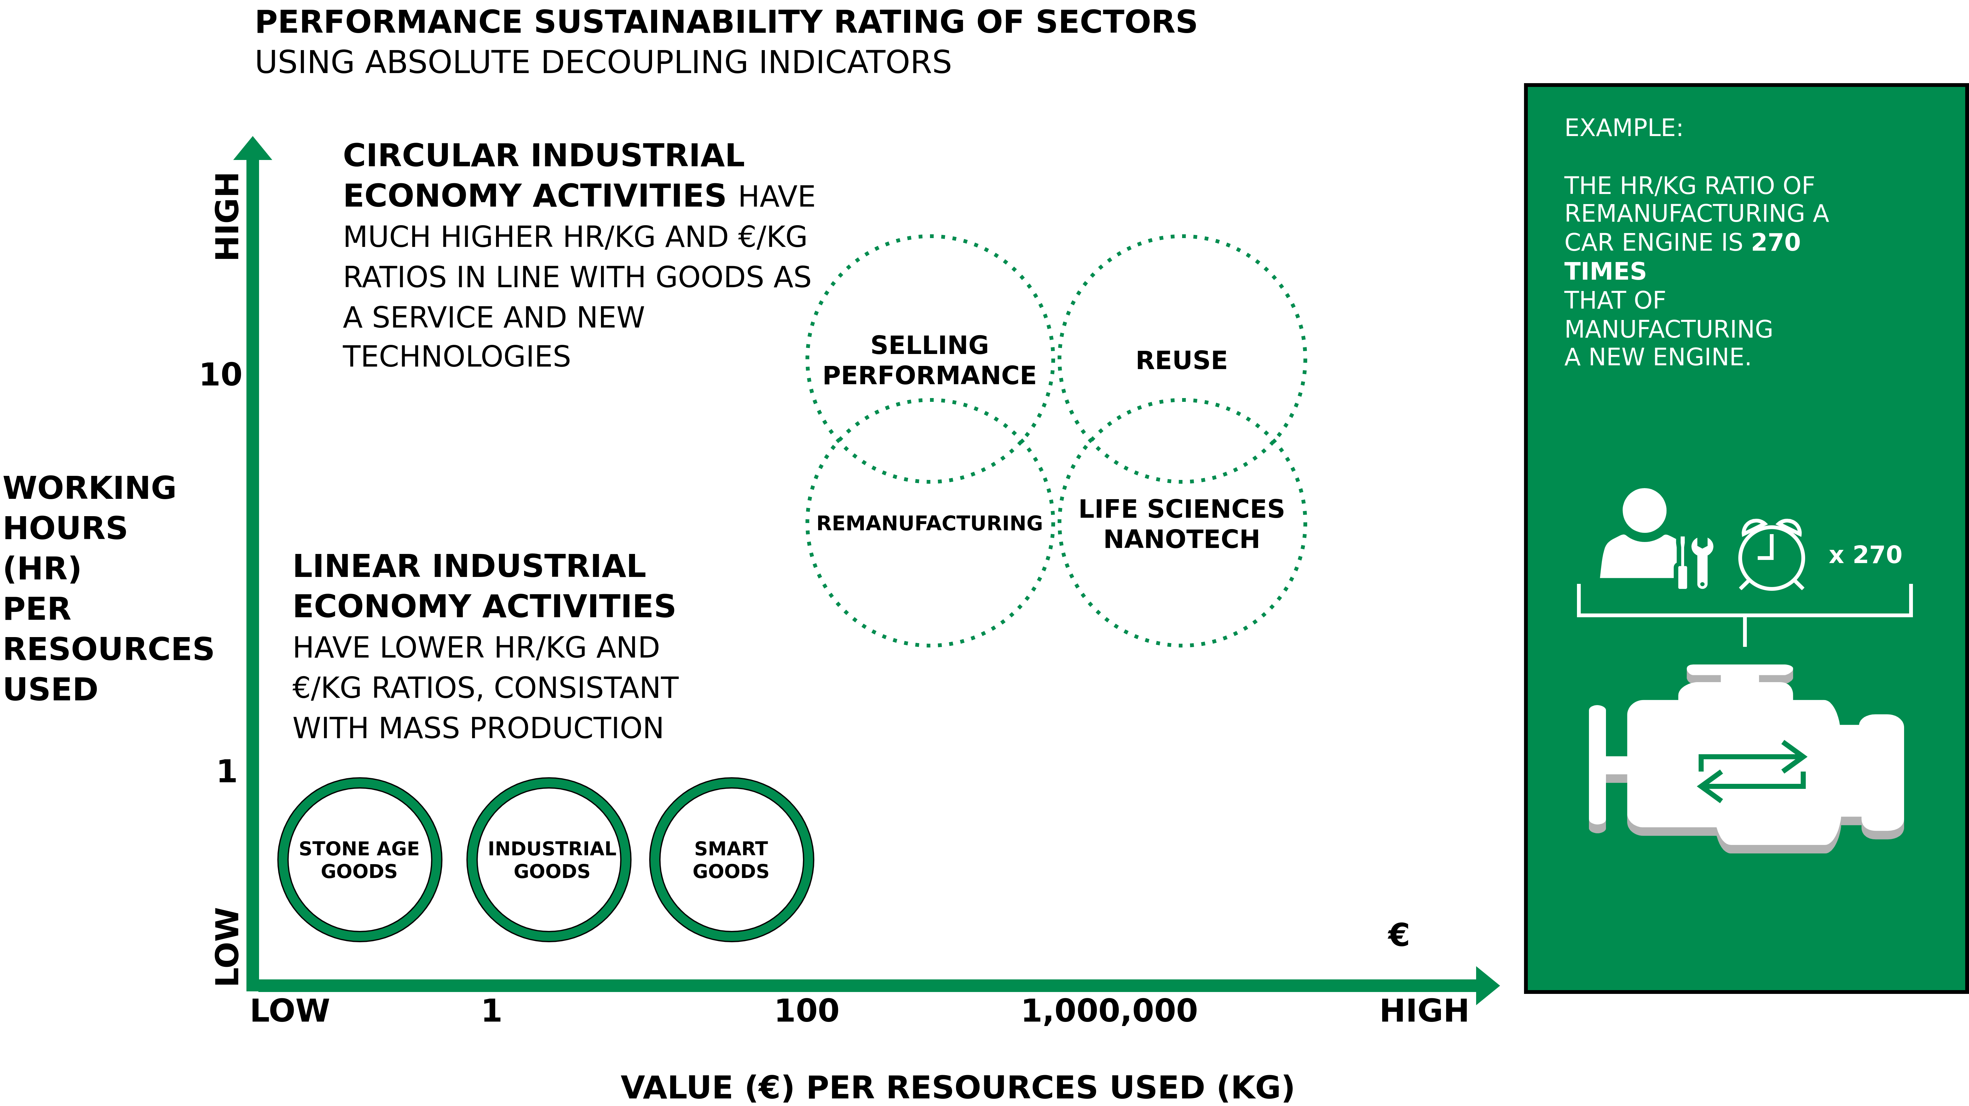
Absolute decoupling indicators make the difference between the LIE and the CIE visible
Image adapted from Walter R. Stahel (2019) – The Circular Economy: A User’s Guide.

Slide 27
Performance Economy

Slide 28
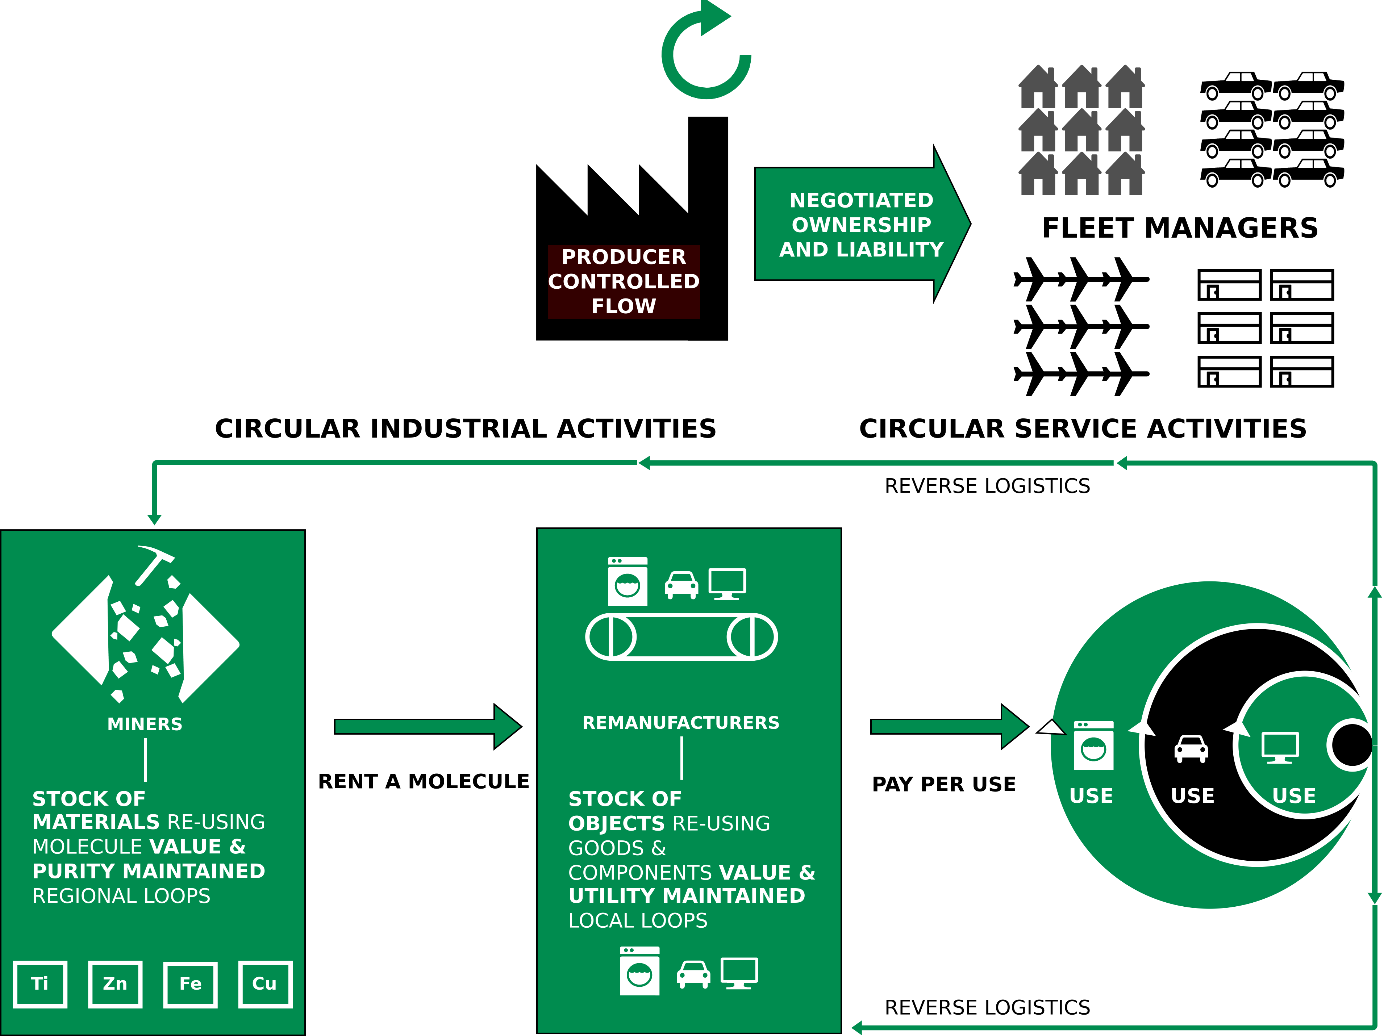
Performance Economy
Image adapted from Walter R. Stahel (2019) – The Circular Economy: A User’s Guide.

Slide 29
Performance Economy – Definition
„The Performance Economy sells results instead of objects. Its economic actors may be manufacturers of durable objects or fleet managers operating them. In both cases, they sell the use of these objects as a service over the longest possible period of time and maximize their profits by exploiting both efficiency and sufficiency solutions. “
Walter R. Stahel (2019) – The Circular Economy: A User’s Guide.

Slide 30
Performance Economy – Most sustainable CE business model?
Stahel argues:
“The Performance Economy of selling goods and molecules as a service, function guarantees or results and performance, is the most sustainable business model of the circular industrial economy because by internalising the costs of product liability, of risk and waste, it offers manufacturers a strong financial incentive to prevent losses and waste.”
Walter R. Stahel (2019) – The Circular Economy: A User’s Guide.

Slide 31
Performance Economy – Most sustainable CE business model?
Stahel argues:
“The Performance Economy of selling goods and molecules as a service, function guarantees or results and performance, is the most sustainable business model of the circular industrial economy because by internalising the costs of product liability, of risk and waste, it offers manufacturers a strong financial incentive to prevent losses and waste.”
“It maximises the profit potential by exploiting sufficiency, efficiency and systems solutions.”
Walter R. Stahel (2019) – The Circular Economy: A User’s Guide.

Slide 32
Performance Economy – Most sustainable CE business model?
Stahel argues:
“The Performance Economy of selling goods and molecules as a service, function guarantees or results and performance, is the most sustainable business model of the circular industrial economy because by internalising the costs of product liability, of risk and waste, it offers manufacturers a strong financial incentive to prevent losses and waste.”
“It maximises the profit potential by exploiting sufficiency, efficiency and systems solutions.”
“In addition, by maintaining the ownership of objects and embodied resources, it creates long-term corporate and national resource security at low cost.”
Walter R. Stahel (2019) – The Circular Economy: A User’s Guide.

Slide 33
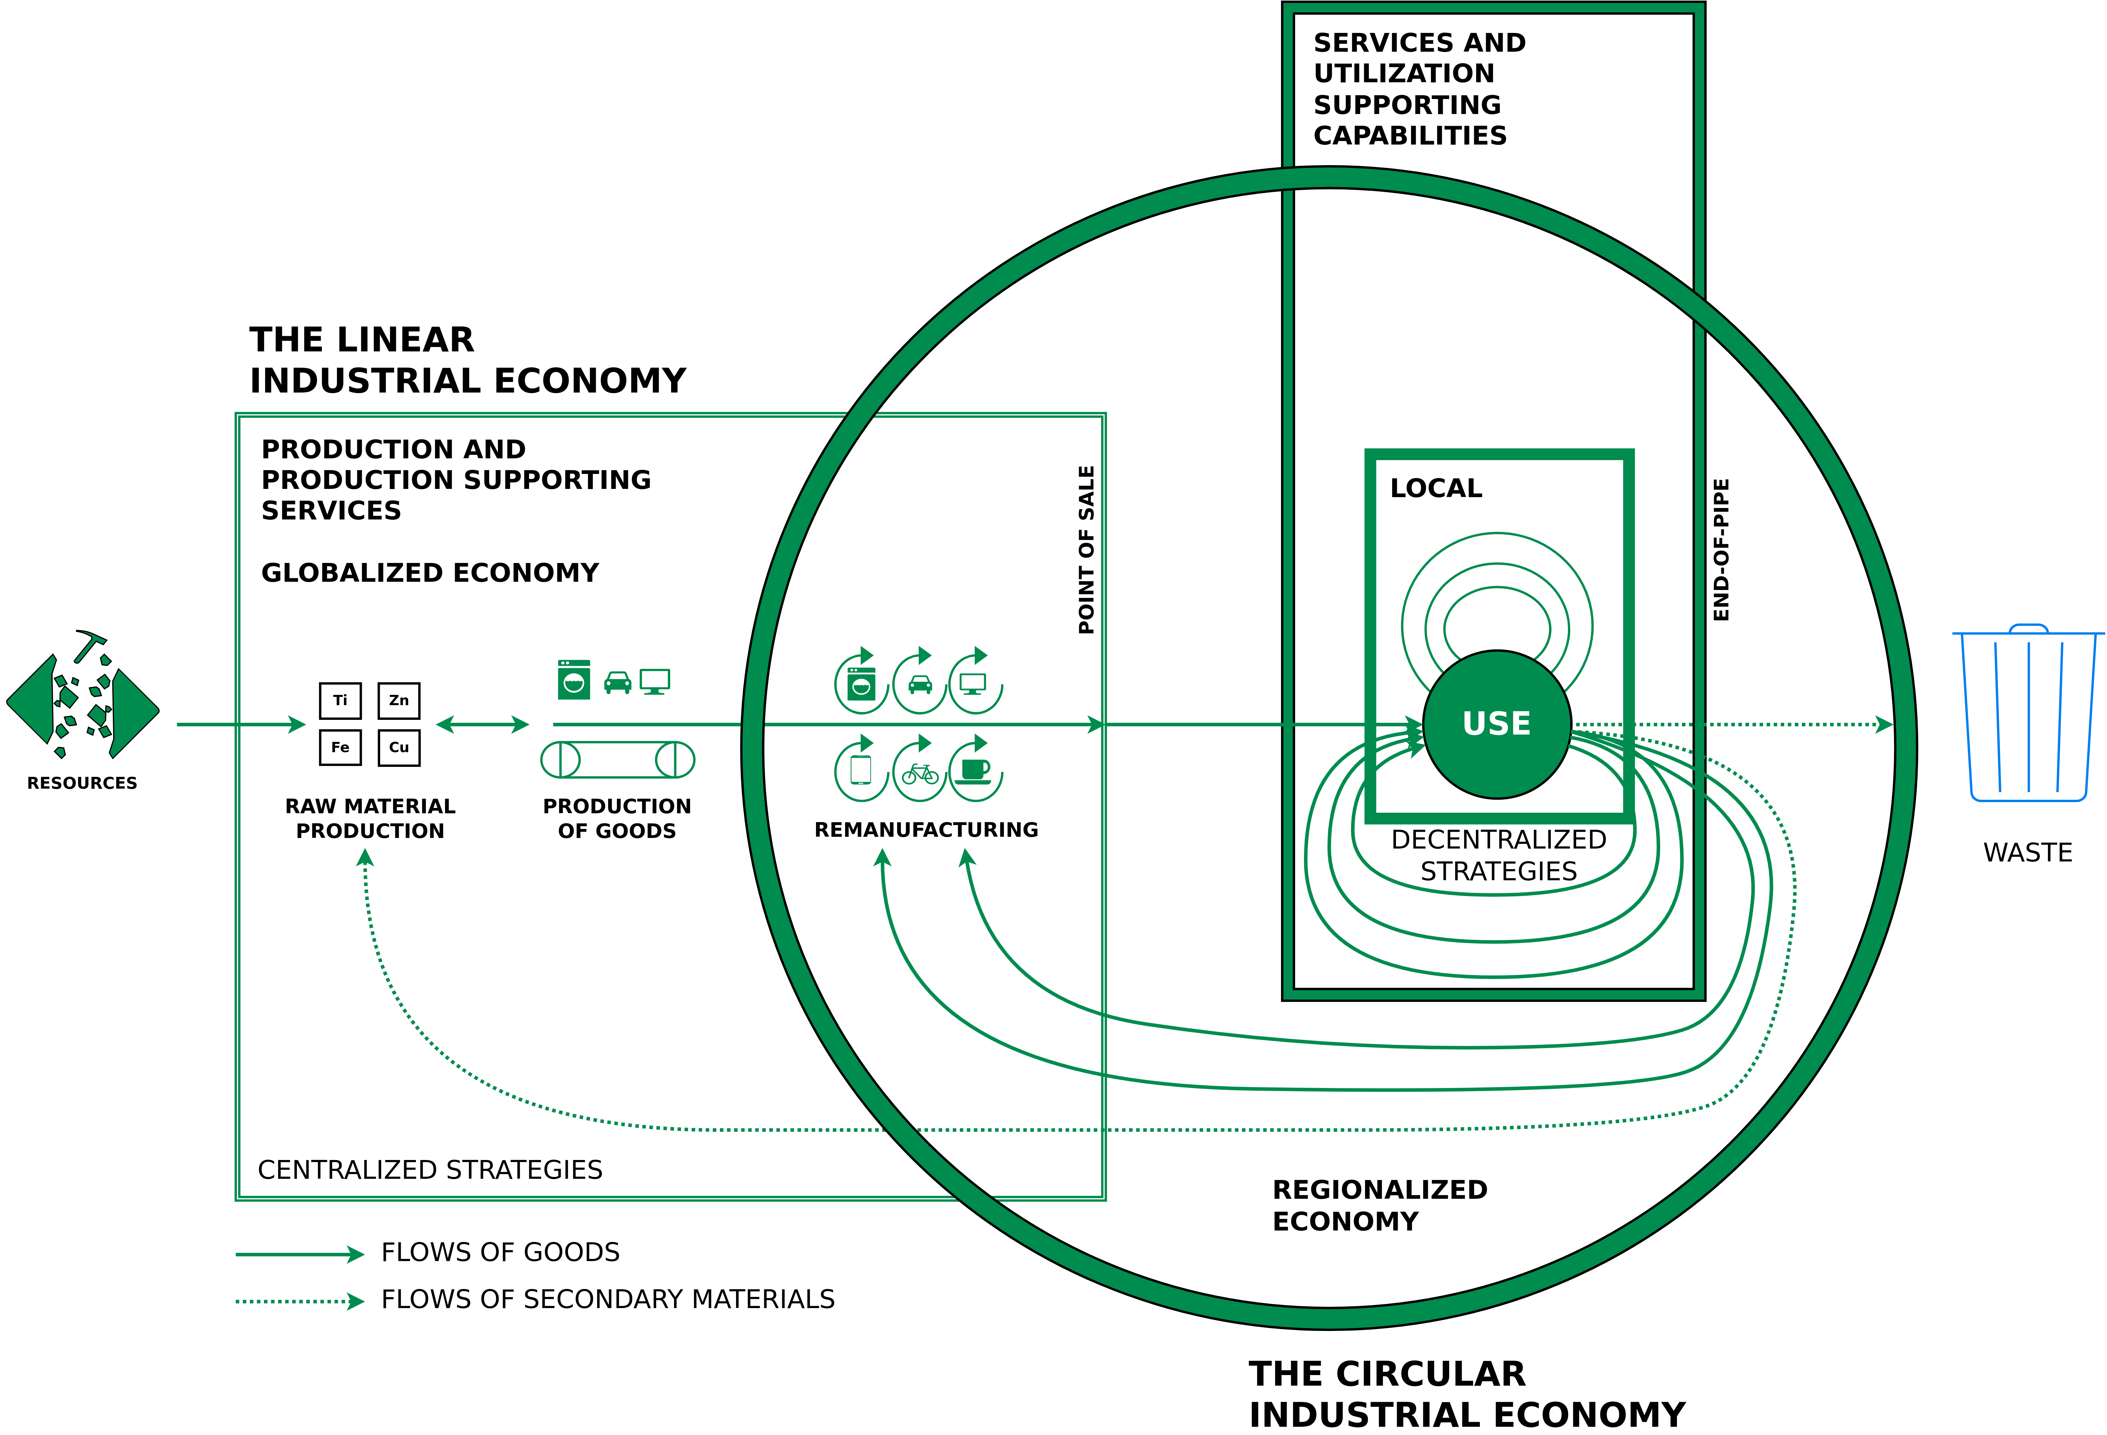
Situating the LIE, the CIE and the PE
Circle: Managing the utilisation or use phase of stocks of manufactured objects and their components, by maintaining the value and quality of infrastructure, buildings, investment goods, equipment and durable consumer goods in a local or regional economy
Small square: Local use-focused PE
Big square: Flows of used materials returning to the raw material producer to recover molecules and atoms in a globalised economy
Walter R. Stahel (2019) – The Circular Economy: A User’s Guide.

Slide 34
Situating the LIE, the CIE and the PE
Circle: Managing the utilisation or use phase of stocks of manufactured objects and their components, by maintaining the value and quality of infrastructure, buildings, investment goods, equipment and durable consumer goods in a local or regional economy
Small square: Local use-focused PE
Big square: Flows of used materials returning to the raw material producer to recover molecules and atoms in a globalised economy
Walter R. Stahel (2019) – The Circular Economy: A User’s Guide.

Slide 35
Situating the LIE, the CIE and the PE
Circle: Managing the utilisation or use phase of stocks of manufactured objects and their components, by maintaining the value and quality of infrastructure, buildings, investment goods, equipment and durable consumer goods in a local or regional economy
Small square: Local use-focused PE
Big square: Flows of used materials returning to the raw material producer to recover molecules and atoms in a globalised economy
Walter R. Stahel (2019) – The Circular Economy: A User’s Guide.

Slide 36
Emerging Technologies for the Circular Economy

Slide 37
The Nature of Technology
In the past many new technologies have emerged and disrupted existing economical models.
Arthur, Brian (2011) – The Nature of Technology: What It Is and How It Evolves.

Slide 38
The Nature of Technology
In the past many new technologies have emerged and disrupted existing economical models.
B. Arthur stipulates that an economy is an expression of its technologies
Arthur, Brian (2011) – The Nature of Technology: What It Is and How It Evolves.

Slide 39
The Nature of Technology
In the past many new technologies have emerged and disrupted existing economical models.
B. Arthur stipulates that an economy is an expression of its technologies
Thus, it can be argued that the current unsatisfying state of the Circular Economy reflects a lack of sufficiently developed technologies that express themselves within the CE.
Or, more precisely – difficulties of the stakeholders in combining the technologies that are required to enable the CE.
Arthur, Brian (2011) – The Nature of Technology: What It Is and How It Evolves.

Slide 40
Digital Circular Economy and Business Models

Slide 41
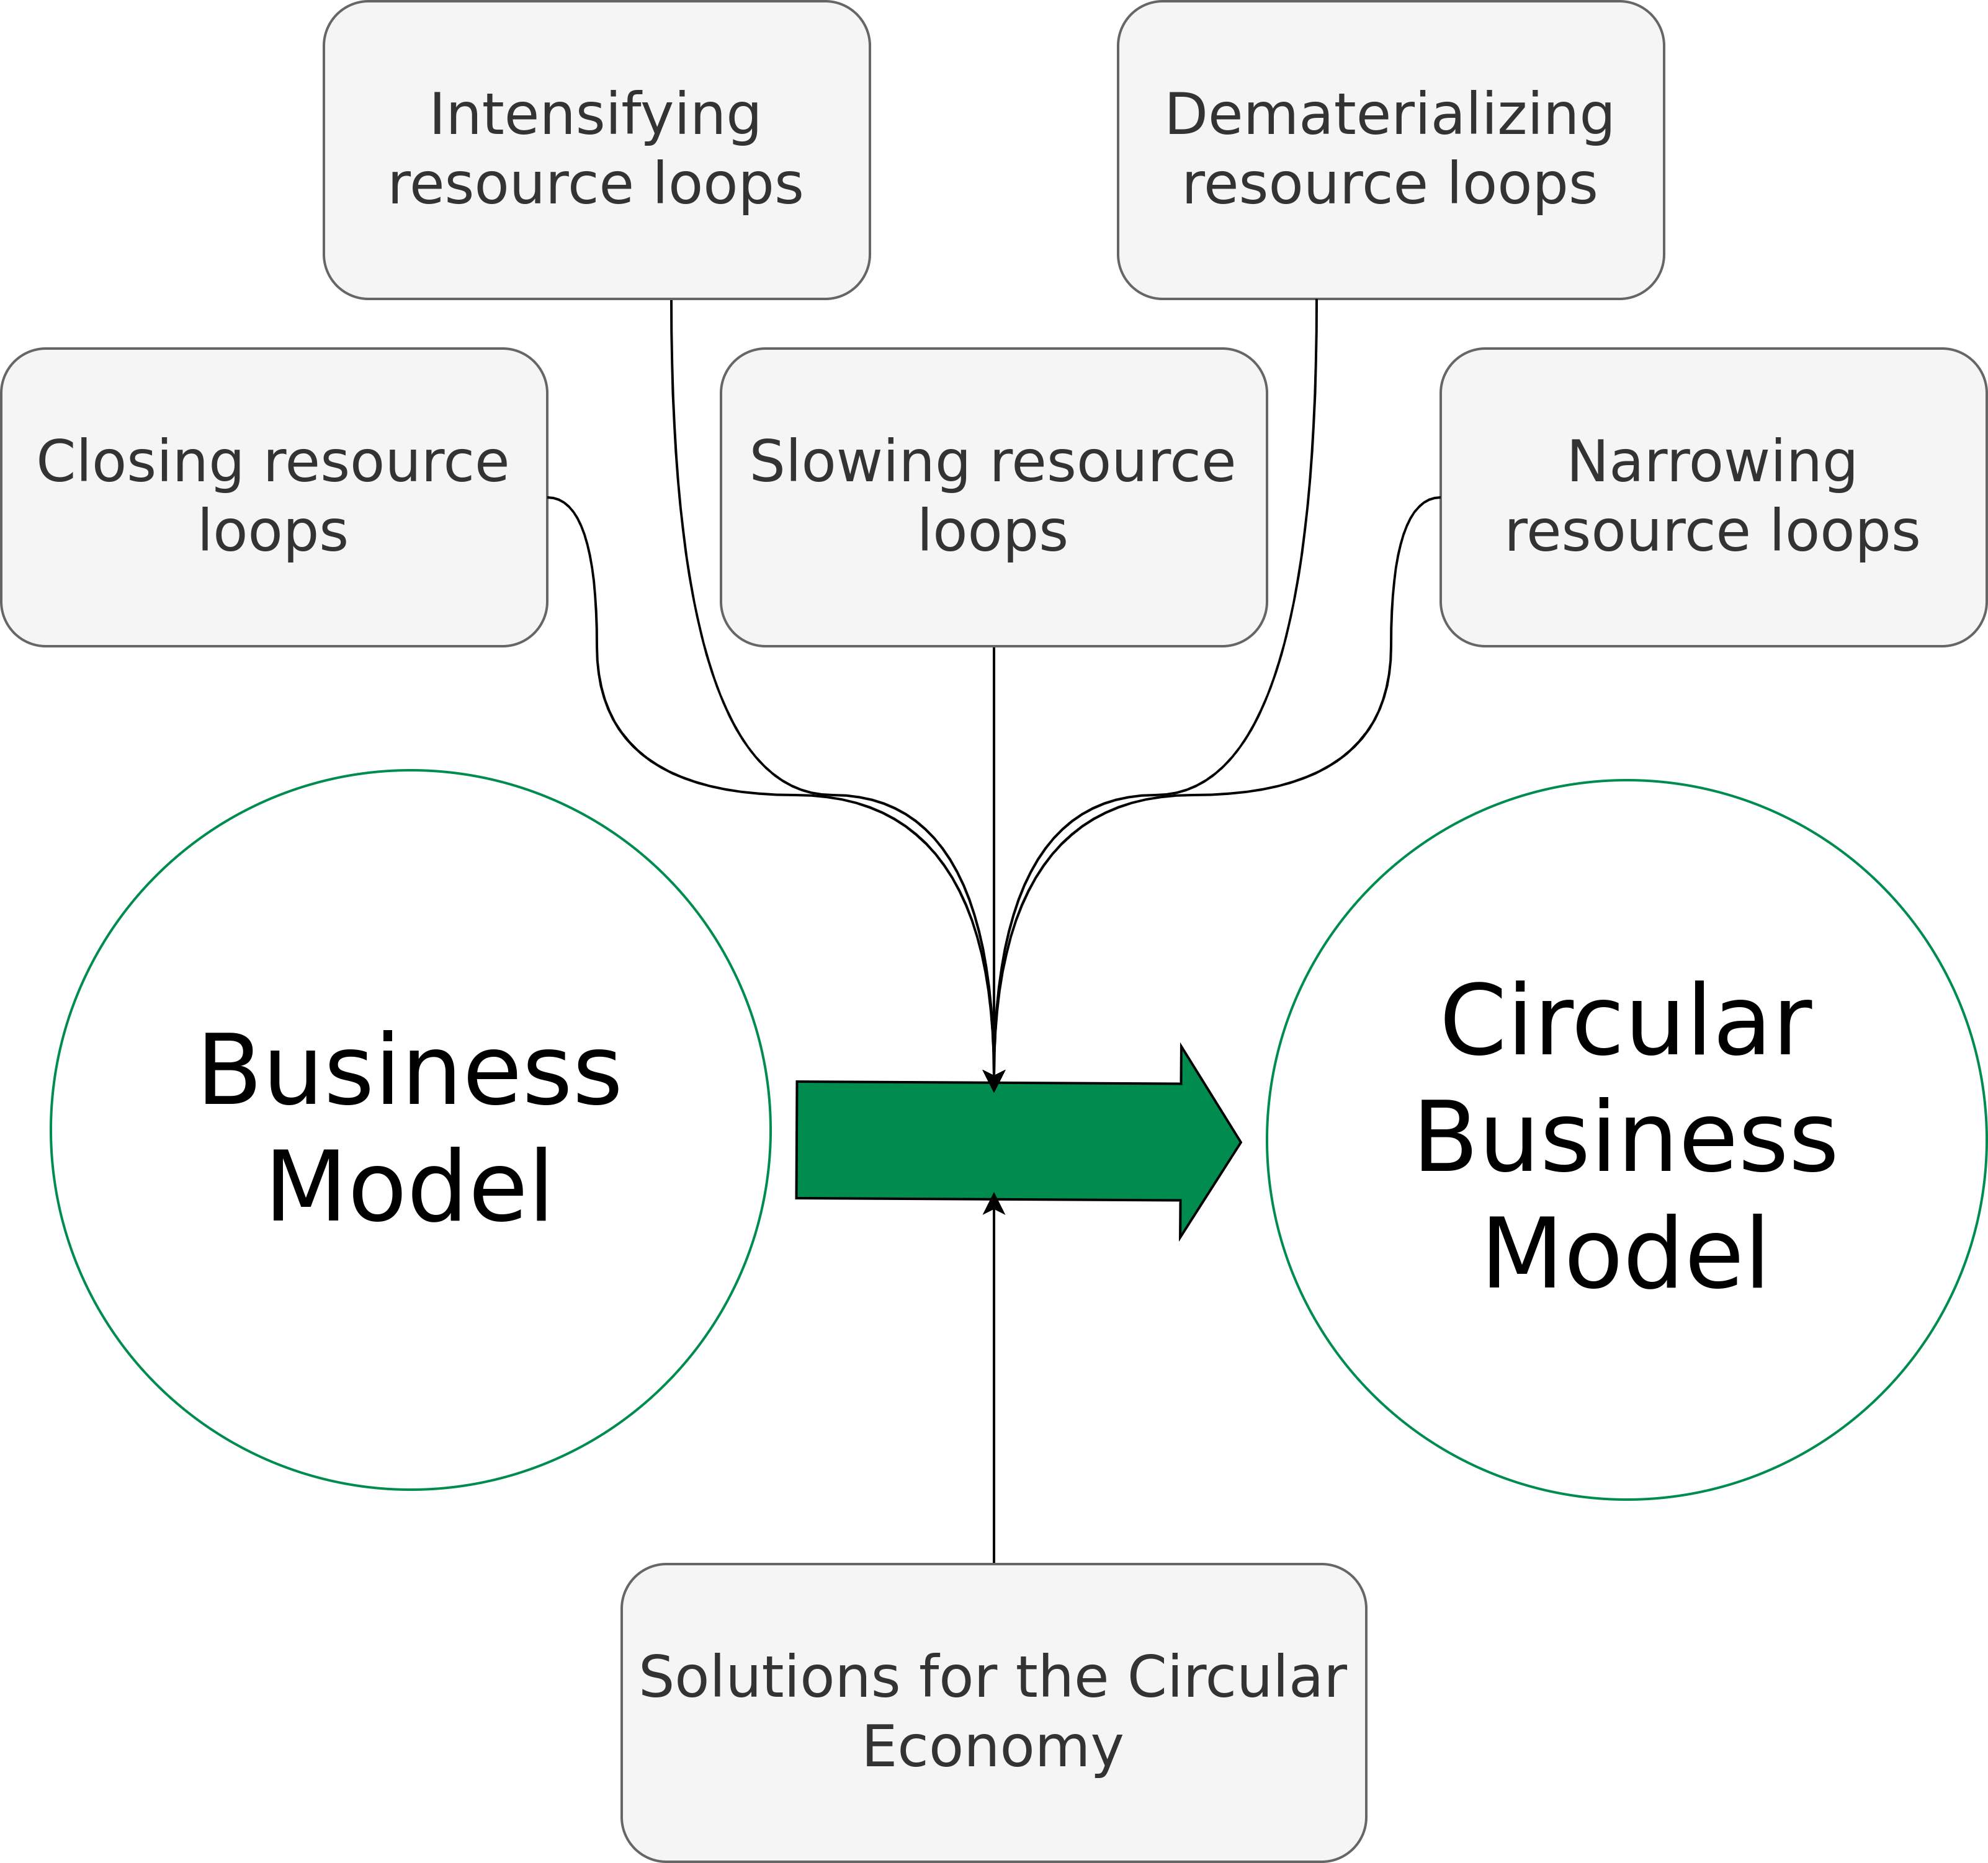
Circular Economy Business Models
Geissdoerfer et al. (2018) – Business models and supply chains for the circular economy.

Slide 42
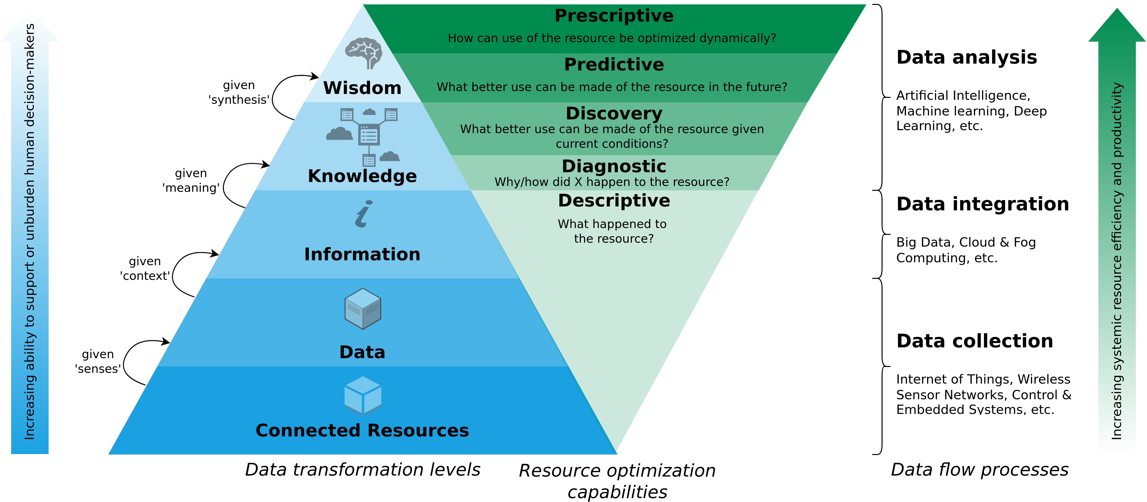
#1: A Data-Driven Smart Circular Economy Framework
Kristoffersen et al. (2020) – The smart circular economy: A digital-enabled circular strategies framework for manufacturing companies.

Slide 43
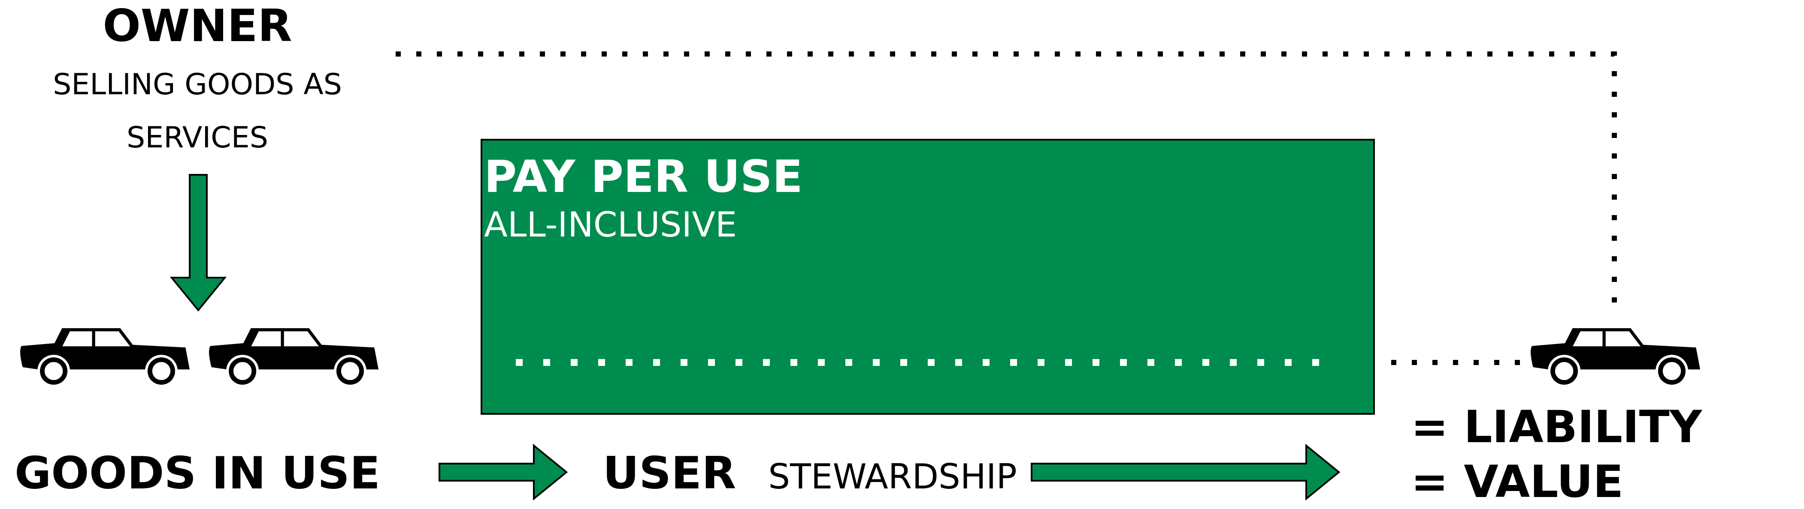
#2: Performance Economy and/to Sharing Economy
Walter R. Stahel (2019) – The Circular Economy: A User’s Guide.

Slide 44
Example 1– Resell?

Slide 45
Resell and Reuse of IT Devices
Momox.co.uk
Ebay-Kleinanzeigen.de
Rebuy.de
https://www.ebay-kleinanzeigen.de
https://www.momox.co.uk
https://www.rebuy.de

Slide 46
Example 2 – Future Resources

Slide 47
Buildings as Material Banks (BAMB)
Integrating “materials passports” with reversible building design to optimise Circular Industrial Value Chains.
Aims of BAMB:
Prevention of construction and demolition waste.
Reduction of virgin resource consumption and the development towards a circular economy through industrial symbiosis.
Addressing the challenges mentioned in the Work Programme on Climate action, environment, resource efficiency and raw materials
https://cordis.europa.eu/project/id/642384

Slide 48
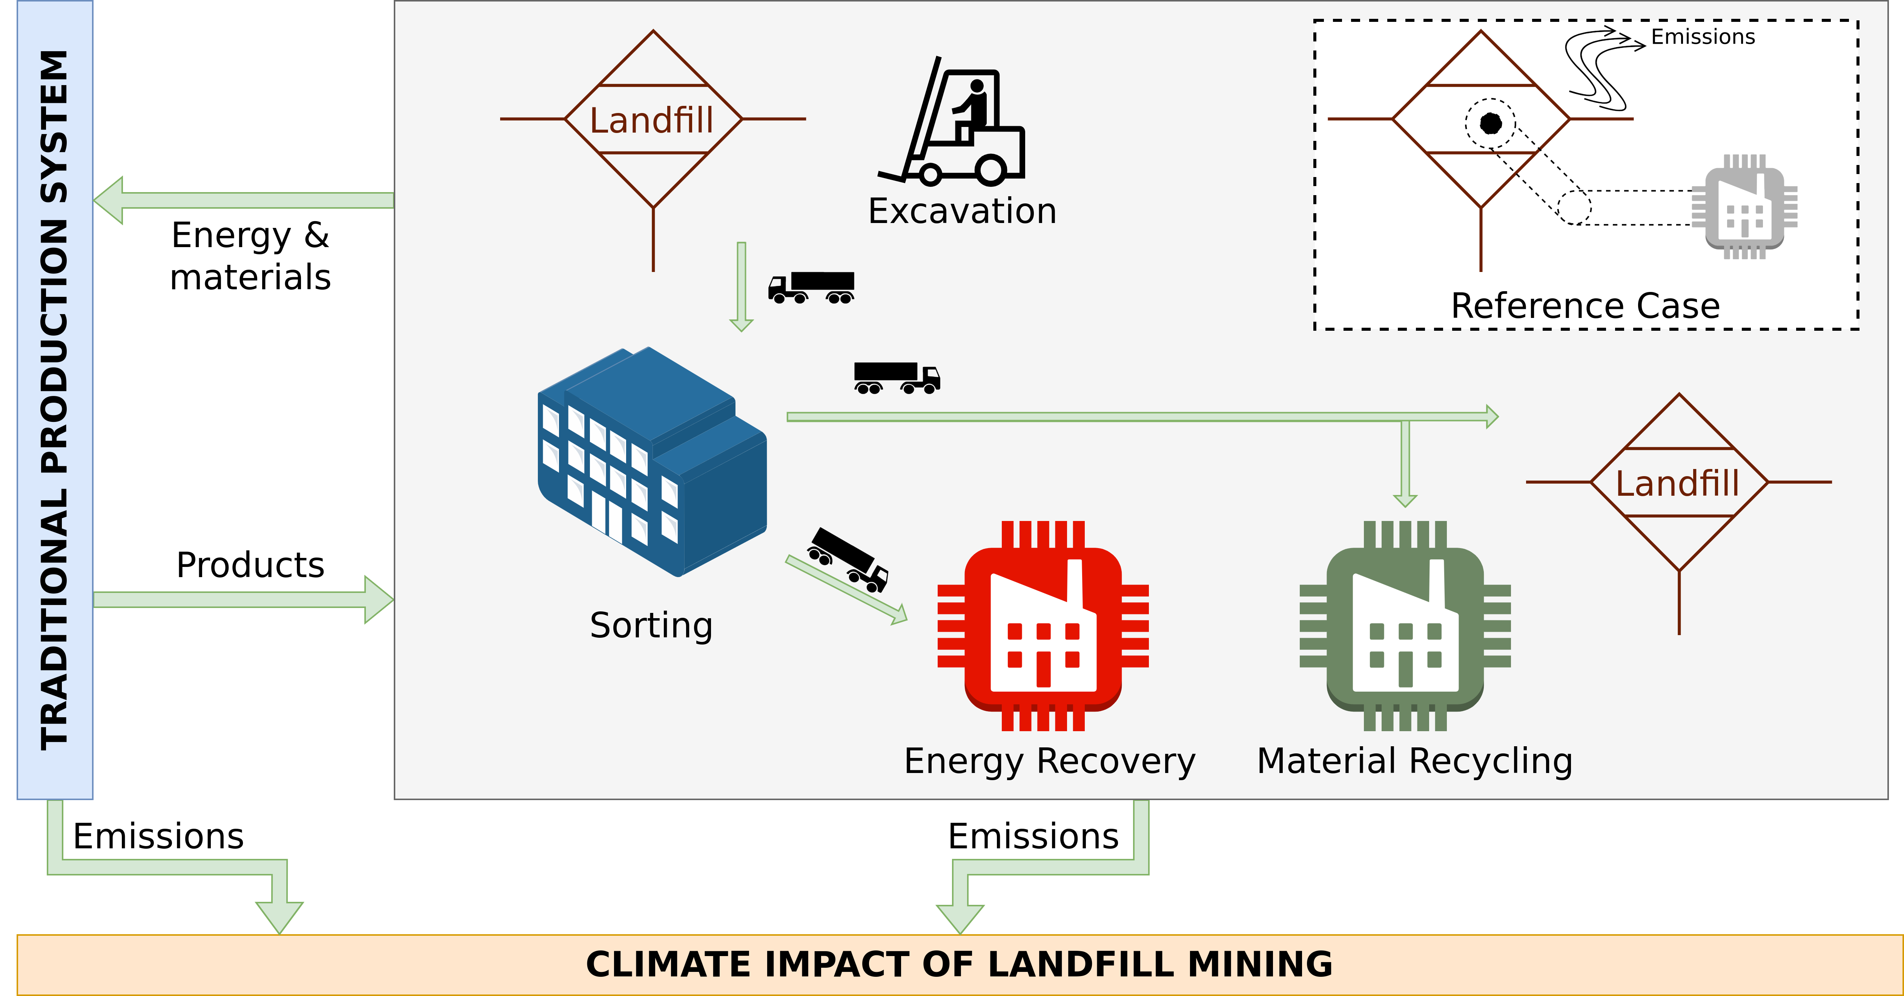
Landfill Mining
Laner et al. (2016) – Quantitative Analysis of Critical Factors for the Climate Impact of Landfill Mining

Slide 49
Example 3 – Digital Twins

Slide 50
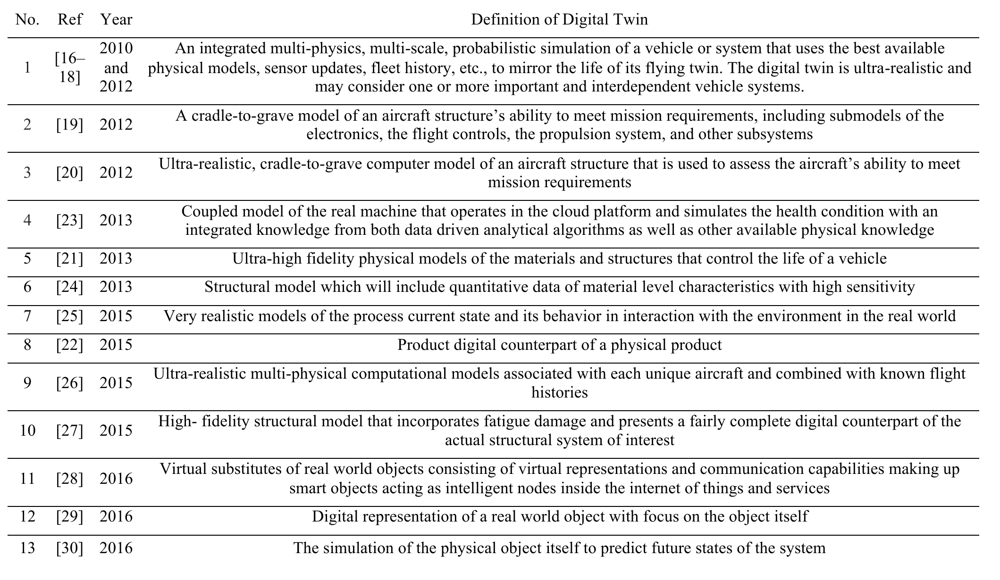
Definitions
Negri et al. (2017) – A Review of the Roles of Digital Twin in CPS-based Production Systems – https://doi.org/10.1016/j.promfg.2017.07.198.

Slide 51
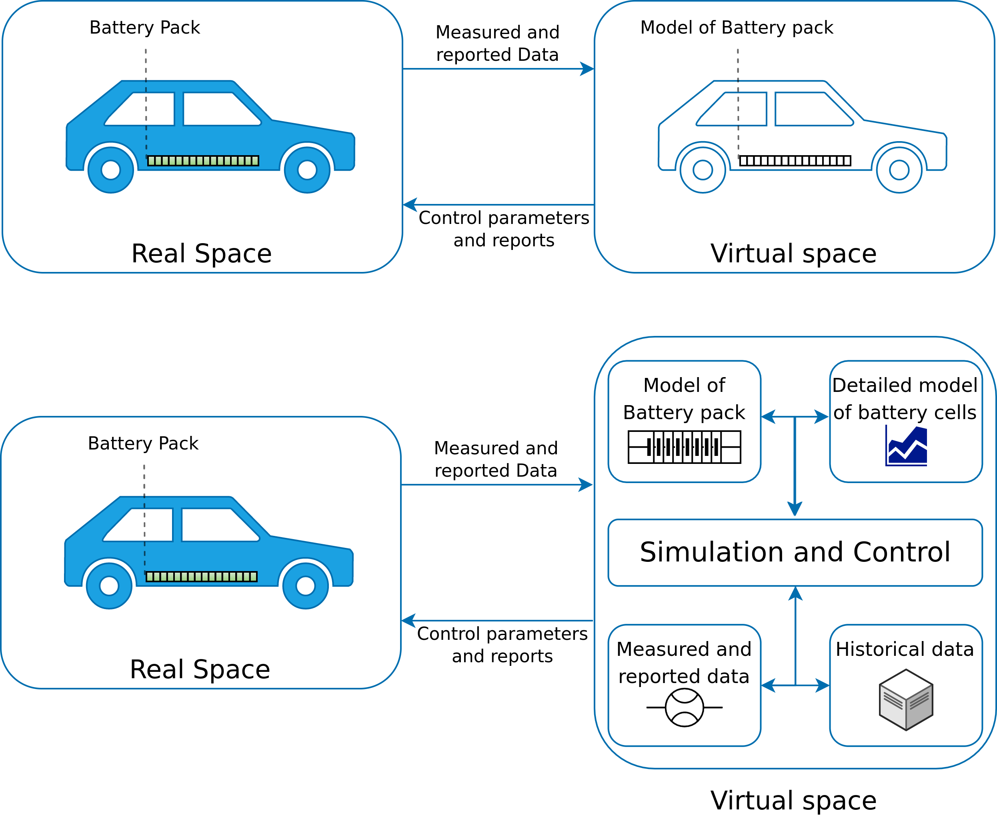
Example 1: Automotive Industry
The digital twin concept exemplified on a battery pack of a BEV.
Image adapted for BEVs from https://www.comsol.com/blogs/digital-twins-not-just-hype/
Notes:
<number>

Slide 52
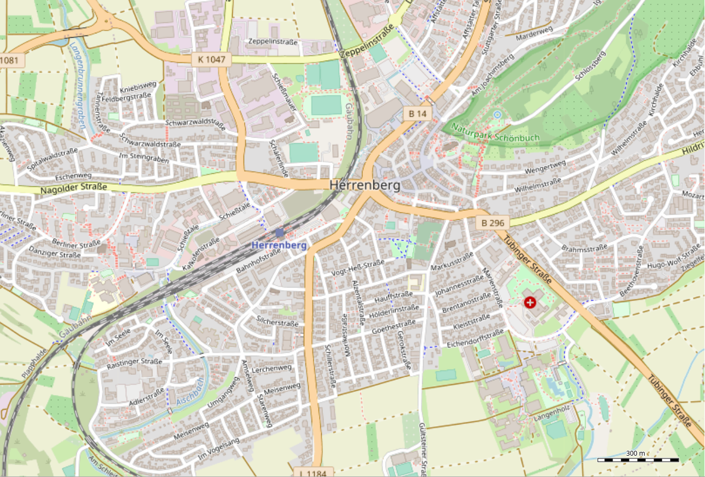
Example 2: Smart Cities
Digital Twin of Herrenberg
Mathematical street network model with space syntax
Used to indicate high/low potentials of traffic.
Sensor network
Temperature
Humidity
Particulate Matter
Air-flow simulation
Simulation and combination of data relates emissions to potential volume of traffic using wind, humidity, temperature and particulate matter data.
3D Visualization of the above using Virtual Reality (VR)
© OpenStreetMap contributors
Dembski, Fabian, et al. "Urban digital twins for smart cities and citizens: the case study of Herrenberg, Germany." Sustainability 12.6 (2020): 2307
Notes:
<number>

Slide 53
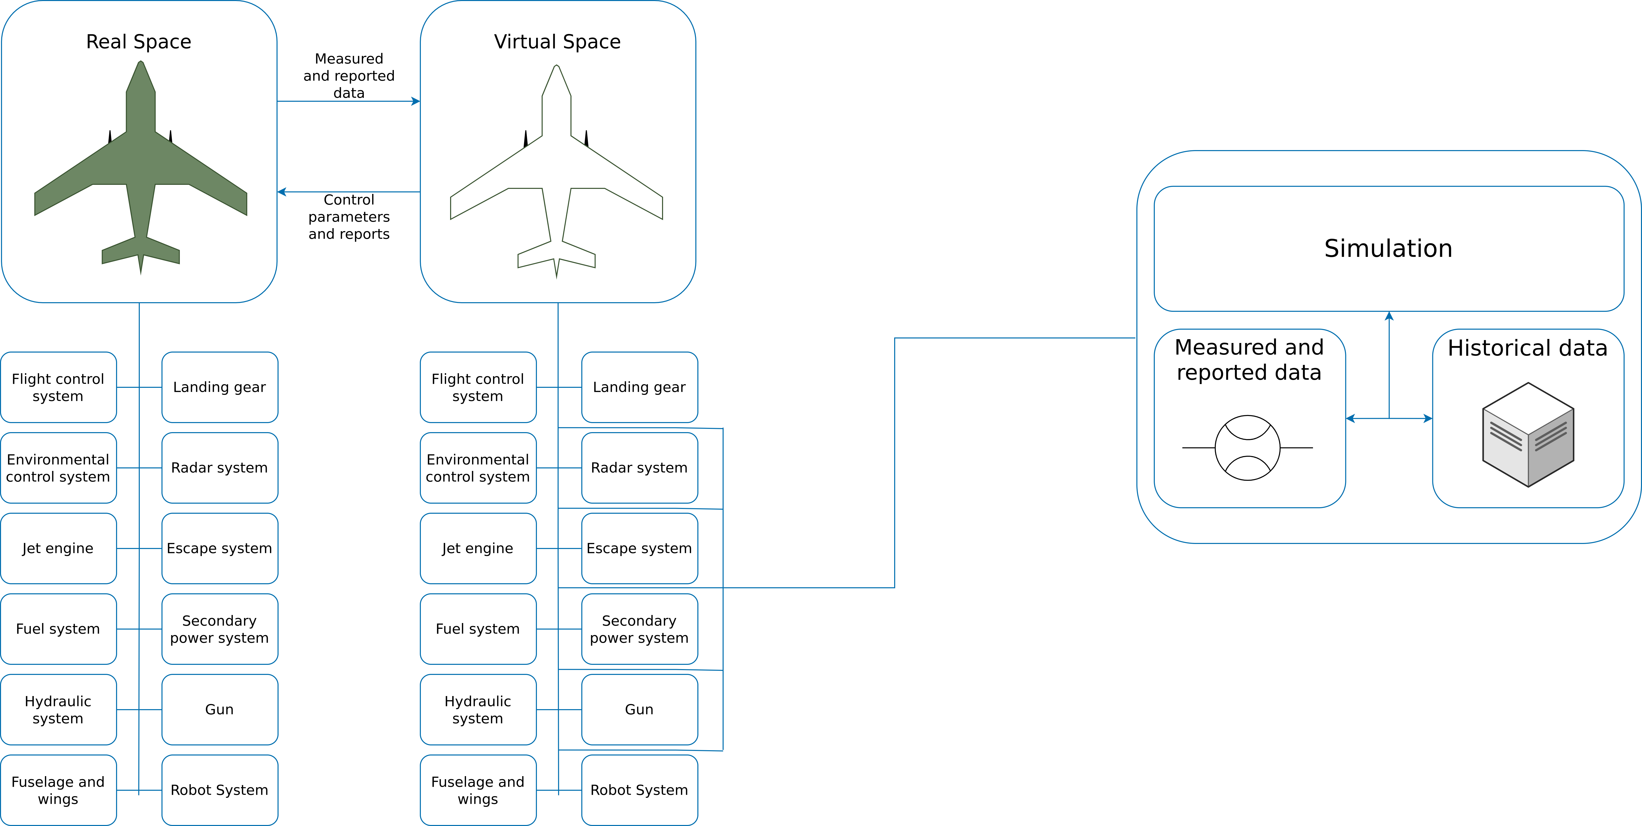
Example 3: Aviation and Aerospace
The figure shows some of the most important subsystems in a fighter jet. A digital twin consists of many different subspaces containing models, simulation data, measured data, and reports for each of the subsystems of the airplane
Image recreated from: https://www.comsol.com/blogs/digital-twins-not-just-hype/
Notes:
-The world’s largest aerospace company Boeing uses a Digital Twin solution for the development of its commercial and military airplanes aimed at improving their quality and safety.
<number>

Slide 54
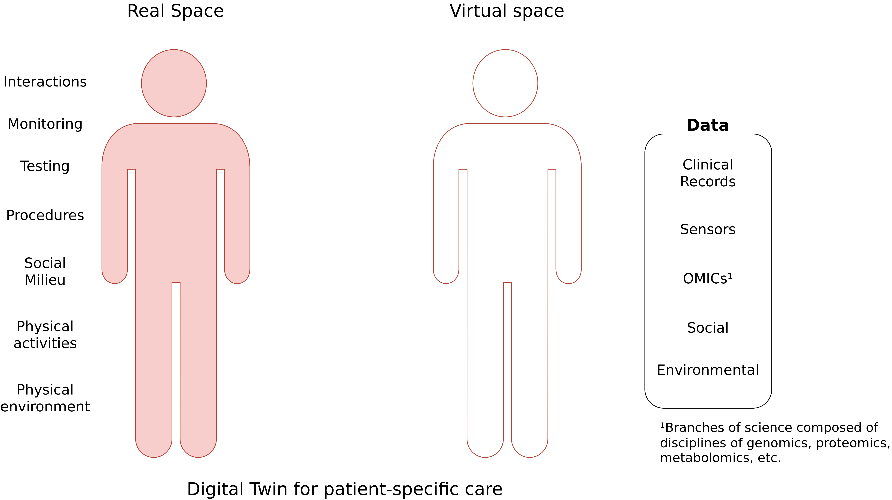
Example 4: Human Medicine
Image adapted from: Rao, Dattaraj Jagdish, and Shraddha Mane. "Digital Twin approach to Clinical DSS with Explainable AI." arXiv preprint arXiv:1910.13520 (2019).
Notes:
<number>

Slide 55
Digital Twins vs. Other Concepts
Digital twins are often compared to be synonymous with simulation, prototype, IoT, etc.
Digital Twin
Simulation
IoT
Prototype's
Notes:
Internet of Things (IoT) defines hundreds of millions of devices that can be connected and controlled via the internet.
On the other hand, digital twin is a virtual replica of an object, system, process, product or service that is digitalized and put on a simulation platform. Digital Twinning, is called a process that involves creating and building a reality-based entity on an online platform. Unlike Internet of Things that must meet the criteria of being able to connect to the Internet and be controlled, a virtual twin can be anything you can imagine.
<number>

Slide 56
Circular Economy
Center for Digital Technologies (DIGIT) (2022) – https://www.digit-research.de/fileadmin/DIGIT/Presse_und_News/Downloads/Grafikpaket_Reallabor_DCE_Kreislaufmodell_V2_ccby.zip – CC BY 4.0.

Slide 57
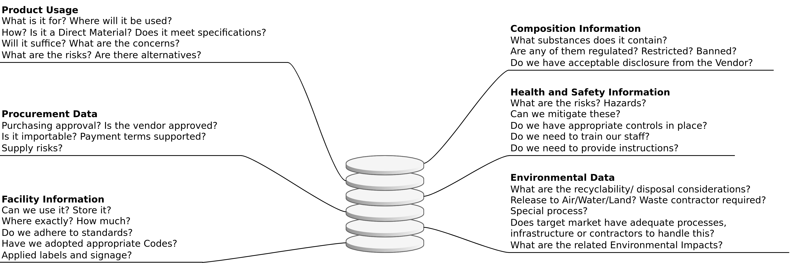
Use Cases (1): Supply Chain Transparency
Relevant Information can be gathered, updated and accessed via a digital twin. Thus creating transparency and traceability.
Based on https://fslci.org/wp-content/uploads/2018/Slides/Sessions/Session_5_Prox.pdf

Slide 58
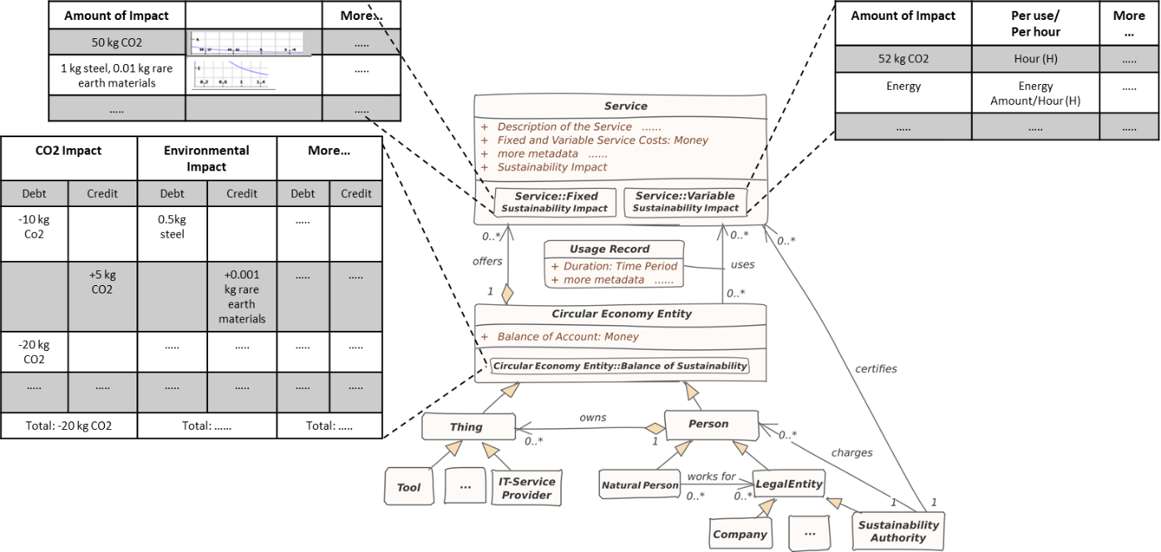
Use Cases (2): Sustainability Impact Factor
Sustainable Ecosystems Engineering Research Group – ISSE TU Clausthal

Slide 59




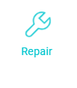
Use Case (3): Increasing the Longevity of Electronics
Lifecycle data
Scenario 1 – Resell
Buyers can access data from the twin and determine if the laptop/product will serve their requirements.
Data transmission
Process data
laptop
Data transmission
Digital twin of the laptop
Scenario 2 - Repair
Repairers can access the twins data to determine the problem, rather then analyze it by themselves. This would save the repair time and cost.
More Transparency, reducing repair costs and traceability, products could be easily leased or shared

Slide 60
Use Case (4): Battery Electric Vehicles
The digital twin concept exemplified on a battery pack of a BEV.
Image adapted for BEVs from https://www.comsol.com/blogs/digital-twins-not-just-hype/
Notes:
<number>

Slide 61
Example 4 – Electric Vehicle Life Cycle Assessment (LCA)

Slide 62
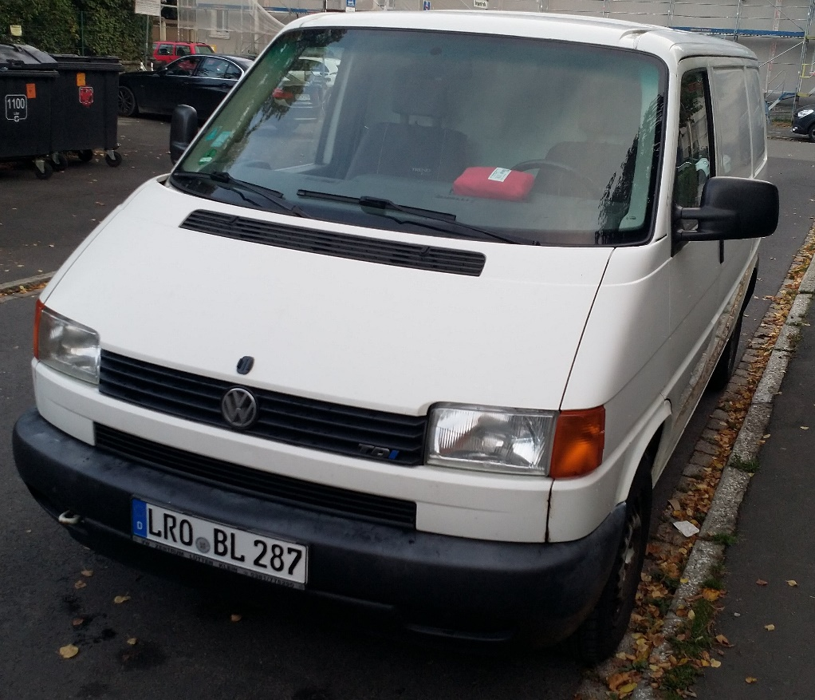
LCA – Motivation

Slide 63
LCA – Motivation
Battery Electric Vehicles (EV)
Or
Internal Combustion Engine Vehicles

Slide 64
EV Break-Even Point?
0 – 50.000km
50.000 – 100.000km
100.000 – 150.000km
150.000 – 200.000km
After 200.000km
What is the break-even point (in km) after which an EV would have caused fewer emissions than an Internal Combustion Engine (ICE?)

Slide 65
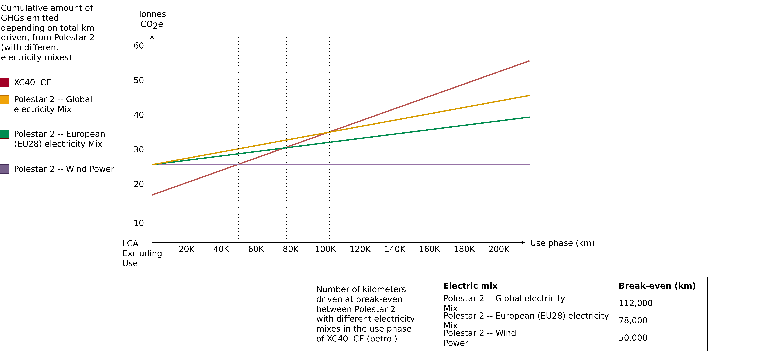
Life Cycle Assessment – Polestar 2
Polestar (2020) – Life Cycle Assessment – Carbon Footprint of Polestar 2.

Slide 66
Further Resources
Baccini et al. (2012) – Metabolism of the Anthroposphere: Analysis, Evaluation, Design
Deutscher Bundestag (1994): Bericht der Enquete-Kommission „Schutz des Menschen und der Umwelt − Bewertungskriterien und Perspektiven für umweltverträgliche Stoffkreisläufe in der Industriegesellschaft“ – Link
Meadows (1972) – The Limits to Growth
Meadows, Randers and Meadows (2004) – Limits to Growth – The 30-Year Update
Walter R. Stahel (2019) – The Circular Economy: A User's Guide
Website of the Ellen MacArthur Foundation – Link

Slide 67
Emerging Technologies for the Circular Economy
Lecture 3: Lifecycle Assessment (LCA)
Prof. Dr. Benjamin Leiding (Clausthal)
Dr. Arne Bochem (Göttingen)
M.Sc. Anant Sujatanagarjuna (Clausthal)
M.Sc. Shohreh Kia (Clausthal)
Notes:
<number>

Slide 68
Questions?

